Slide 1

Development of A Low-Cost Real-Time Bioelectrical Signal Acquisition Module
2020 2nd International Conference on Sustainable Technologies
for Industry 4.0 (STI), 19-20 December, Dhaka
Paper ID- 243
Md. Shah Kamal, Erteza Tawsif Efaz, Md. Fakhrul Alam,
Md. Masud Rana, Syed Nazmus Sakib, Shekh M. M. Islam.
Department of Electrical & Electronic Engineering, University of Dhaka, Department of Electrical & Electronic Engineering, Ahsanullah University of Science & Technology, Department of Electrical, Electronic & Communication Engineering, Military Institute of Science & Technology, Daffodil International University, Dhaka

Slide 2
Bioelectrical Signals
The change in electric current produced by the sum of an electrical potential difference across a specialized tissue, organ or cell system like the nervous system.
The best-known bioelectrical signals are:
      Electroencephalogram (EEG)- [100 µV-2 mV, 1-50 Hz]
      Electrocardiogram (ECG)- [1mV- 5mV, 0.5-20Hz]
      Electromyogram (EMG)- [0V-10 mV, 0-500 Hz]
      Electrooculography (EOG)- [50 µV- 3500µV, 0-100 Hz]

Slide 3
Importance of Acquisition
Diagnosis
Patient Monitoring
Human Machine Interfacing (HMI)
Biomedical Research

Slide 4
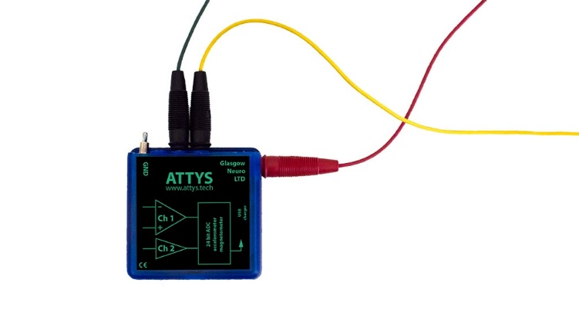
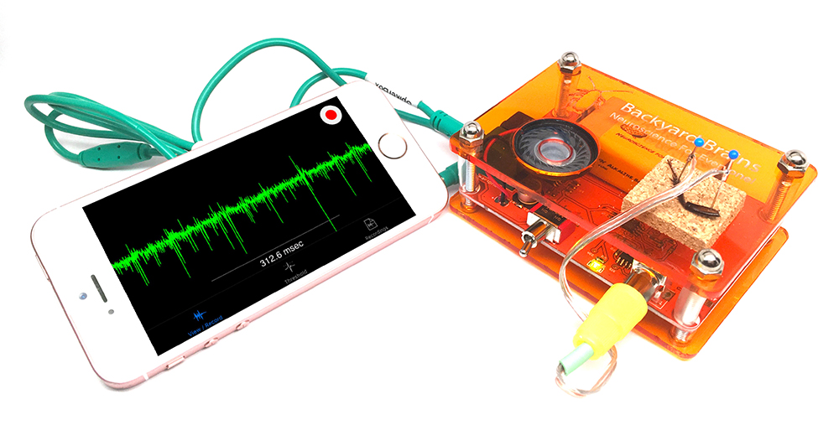
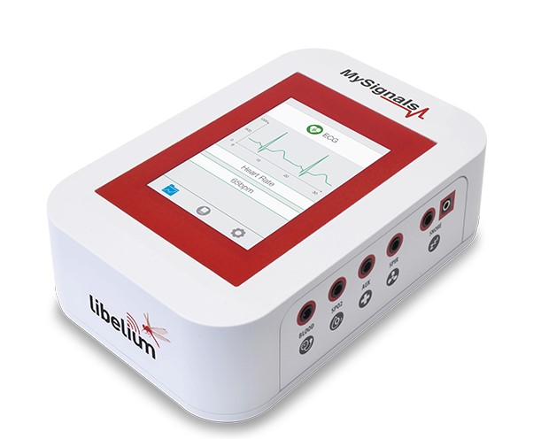
Motivation
Health Monitoring Devices and Kits- MySignal, Attys, Backyard Brain Spiker Kit etc.
Different Biosignals Can Measure in Single Device
Many features of Signal Acquisition
Wireless and Cloud Storage Facilities
Developed Apps for Analysis
Fig. 1: Health Monitoring Devices and Kits.

Slide 5
Objectives
Development of an acquisition system for ECG, EMG, and EOG
Algorithm development for Analog-to-Digital Conversion (ADC).
Establishing a Simulink model for digital filtration.
Executing a MATLAB program for spectrum analysis.
Testing the module performance for different subjects.

Slide 6
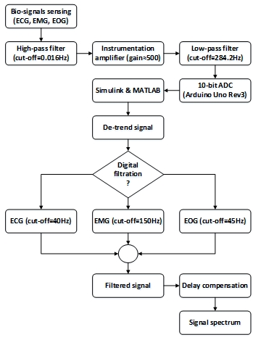
Algorithm

Slide 7
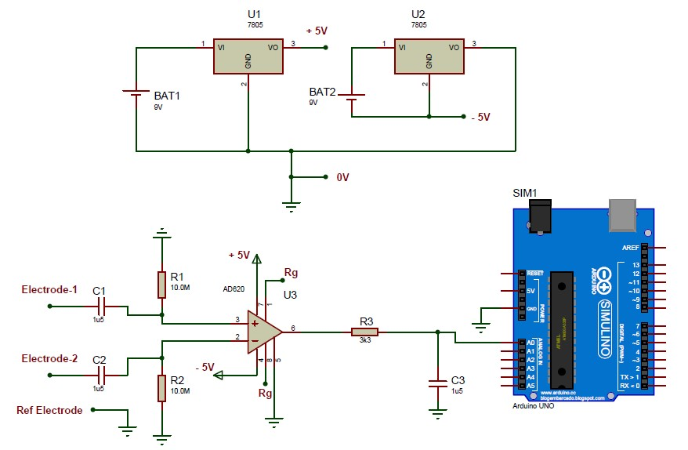
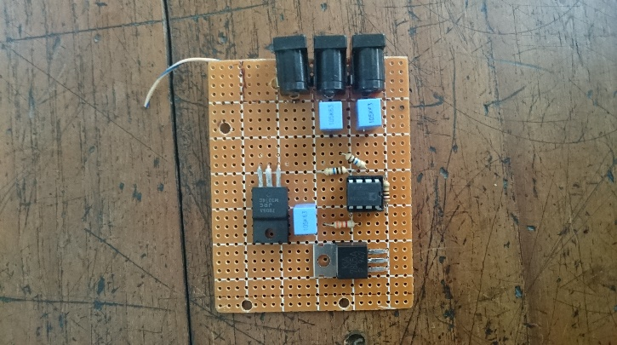
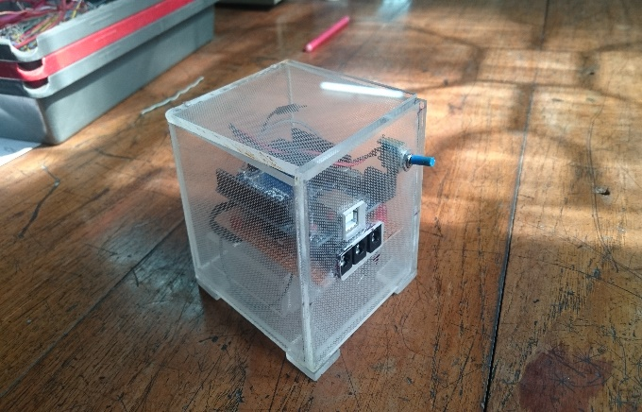
Schematics & Prototype
Fig. 2: Circuit Diagram
Fig. 3: Prototype

Slide 8
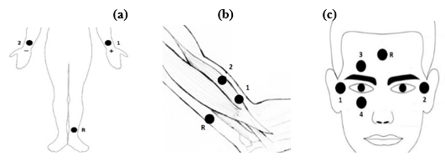
Placement of Electrodes
Fig. 4: Placement of Electrodes for EMG, ECG and EOG

Slide 9
Result
(a)
(b)
Fig. 5: Acquired ECG signal (a) Noisy, (b) Filtered.

Slide 10
Result
(a)
(b)
Fig. 6: Acquired EMG signal (a) Noisy, (b) Filtered.

Slide 11
Result
(a)
(b)
Fig. 7: Acquired EOG signal (horizontal movement) (a) Noisy, (b) Filtered.

Slide 12
Result
(a)
(b)
Fig. 8: Acquired EOG signal (vertical movement) (a) Noisy, (b) Filtered.

Slide 13
Result
Table 1. Signal analysis data of tests.
Signal Type | Age of Subjects | Frequency Range (Hz) | Voltage Range (mV)
ECG | 14 | 0 ~ 30 | 0 ~ 2.50
 | 26 | 0 ~ 35 | 0 ~ 3.12
 | 48 | 0 ~ 38 | 0 ~ 3.18
EMG | 14 | 0 ~ 130 | 0 ~ 2.10
 | 26 | 0 ~ 140 | 0 ~ 2.00
 | 48 | 0 ~ 140 | 0 ~ 2.15
EOG (Horizontal) | 14 | 0 ~ 30 | 0 ~ 0.15
 | 26 | 0 ~ 35 | 0 ~ 0.18
 | 48 | 0 ~ 40 | 0 ~ 0.20
EOG (Vertical) | 14 | 0 ~ 40 | 0 ~ 1.50
 | 26 | 0 ~ 42 | 0 ~ 1.50
 | 48 | 0 ~ 45 | 0 ~ 1.80

Slide 14
Result
Table 2. The material cost of the method.
Specified Component | Quantity | Price (US$) | Aggregated (US$)
Arduino Uno (R3) | 1 | 5.66 | 5.66 [22]
Instrument. Amplifier (AD620) | 1 | 5.49 | 5.49 [23]
Voltage Regulator (LM7805) | 2 | 0.12 | 0.24 [24]
Rechargeable Batteries (9V) | 2 | 3.24 | 6.48 [25]
Electrodes (Bio Protech T716) | 3 | 0.09 | 0.27 [11]
Resistors (10MΩ and 560Ω) | 3 | 0.04 | 0.12 [26, 27]
Capacitors (1µF) | 3 | 0.02 | 0.06 [28]
Breadboard (mini) | 1 | 0.06 | 0.60 [29]
Others | clips, wires, holders | estimated | 5
Total | - | - | 24.19

Slide 15
Conclusion
There is noise in acquainted signal. This noise due to-
50 Hz noise in line voltage
Contact deflection between connecting
Using normal cable
The problem can be solved by using-
Optocoupler circuit
Making the circuit in PCB
Using co-axial cable

Slide 16
Future Work
Mobile and Computer Application for Signal Analysis
Assistive system for disable people
Health Monitoring Devices
Human Machine Interfacing (HMI)

Slide 17
Thank You

